Slide 1
INTERNSHIP REPORT · 2024
AI/ML Internship Report
Panchal Shlok Dipakkumar · Enrollment No: 220170146036
CSE (Data Science) · AI/ML Intern

Slide 2
Infopulse Technology
About
Services Offered
IT & Software Development company based in Bhuyangdev & Sola (Science City Road), Ahmedabad, Gujarat
Web & Mobile Development
AI
Location
IoT
Blockchain
734, Solaris Business Hub, Bhuyangdev, Sola Road, Ahmedabad
UI/UX
Digital Solutions

Slide 3
Project Overview
AI-Powered Personal Assistant Chatbot
A full-stack chatbot built with FastAPI + React. Users chat naturally in plain English to manage work — no forms, no menus, just conversation.
Intent Understanding
Session Memory
Automatically understands intent (email, calendar, tasks, employee data)
Remembers past conversations across sessions
Google Integration
Security
Connects to real Google services (Gmail, Calendar, Tasks)
Secured with JWT authentication + Google OAuth

Slide 4
Technology Stack
Backend
Frontend
FastAPI, MongoDB Atlas, Redis, Groq LLM (llama-3.1-8b), Gemini Embeddings, Google APIs
React, Vite, Tailwind CSS, Axios
Infrastructure
AI Layer
MongoDB Vector Search, Redis cache, JWT auth, Google OAuth 2.0
LLM-based intent detection, RAG pipeline, rolling conversation summarisation

Slide 5

System Architecture
Flow: React → FastAPI → LLM Intent Detector → Route to Handler
React Frontend
FastAPI Backend
LLM Intent Detector
Route to Handler
Seven intent routes: email_send & email_read (Gmail API), calendar (Google Calendar API), tasks (Google Tasks API), db_query & crud (MongoDB), and default (RAG vector search on employee KB). Redis stores active multi-step flow state per user so email compose and calendar creation flows don't break mid-conversation.

Slide 6
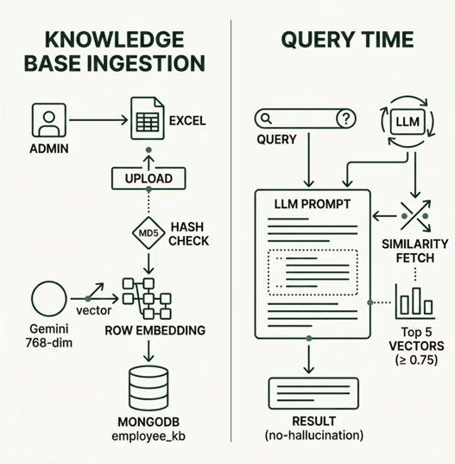
RAG Pipeline & AI Memory
01
Session Loading
Last 20 messages loaded per session
02
Auto-Summarisation
Auto-summarised when token limit (10,000) is reached
03
Cross-Session Memory
Past session summaries injected as cross-session memory
04
Thread Titles
Thread titles auto-generated after first exchange

Slide 7
Core Features & Functionalities
Email Management
Calendar Management
Compose, send, read Gmail emails through natural conversation
Create Google Calendar events with attendee support
Task Management
Employee Knowledge Base
Add, view, and complete personal Google Tasks
Ask about any employee's details — name, email, phone, department, location
Employee CRUD
Multi-turn Flows
Add, update, or delete employee records from the database
Email and calendar creation are guided step-by-step, asking for missing info

Slide 8
Database Design
MongoDB Collections
Redis Keys
users — email, hashed password, Google token
threads — chat sessions, title, user reference
messages — role, content, timestamp
employee_kb — text, 768-dim embedding, metadata
ingestion_manifest — Excel filename + MD5 hash
summaries — per thread rollback summary
email_state:{user_id}
cal_state:{user_id}
Tracks in-progress calendar creation flow
Tracks in-progress email compose flow

Slide 9
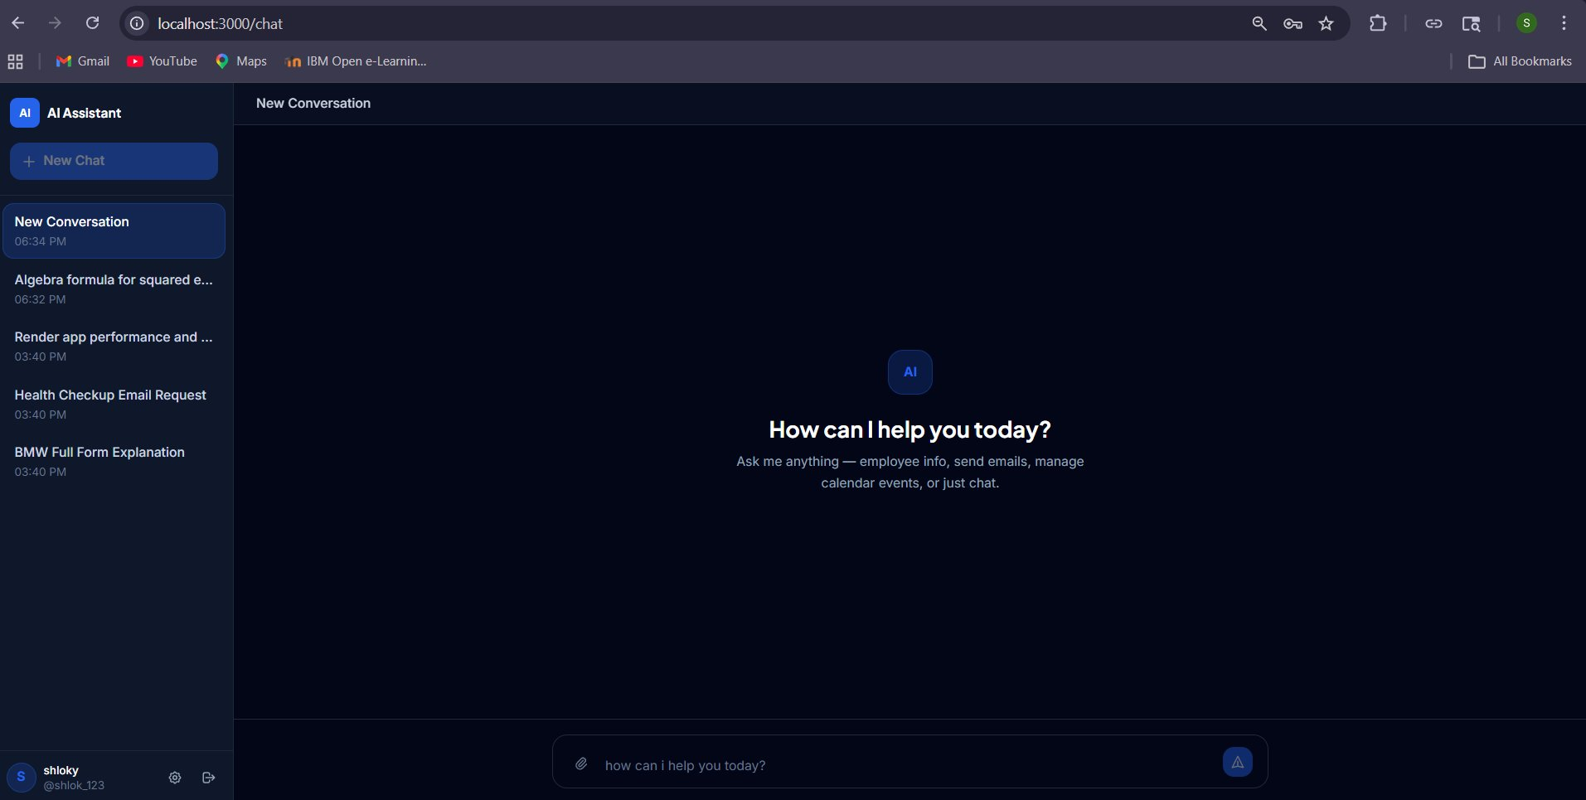
UI Walkthrough
Screens
Example Conversations
Login / Register — JWT-based auth
Chat Page — Sidebar with thread history + main chat window + message input
Profile Modal — Connect Google account (Gmail + Calendar + Tasks)
"Send an email to Priya about tomorrow's meeting" → bot guides through subject, body, confirmation → sends
"Schedule a standup every Monday at 10am with the dev team" → extracts recurrence, attendees → creates event
"List all AIML interns in Surat" → queries MongoDB → returns filtered list
"What is Anand's phone number?" → RAG search → returns only that one field
"Add a task: submit report by Friday" → creates Google Task instantly

Slide 10
Challenges & Learnings
Multi-turn Flows
Redis state kept email/calendar flows alive across API calls
RAG Hallucination
Prevented by strict prompt rules + similarity score threshold (≥ 0.75)
Excel Re-ingestion
MD5 hash optimisation — no wasted API calls on unchanged data
Intent Edge Cases
"List tasks" vs "list employees" required detailed LLM prompt with conflict resolution rules
Cross-session Memory
Built by summarising old threads and injecting them as context

